Slide 1


FODDER – Food at your Doorstep

Slide 2
About
1
The java project is a user interface for Hotel/Restaurants to allow its customers to order the food with ease.
2
Customers can order any kind of food provided by the particular Restaurant/Hotel and get the total price with taxes included and even options to dine-in or home delivery. Customer also gets option to choose its mode of payment.

Slide 3
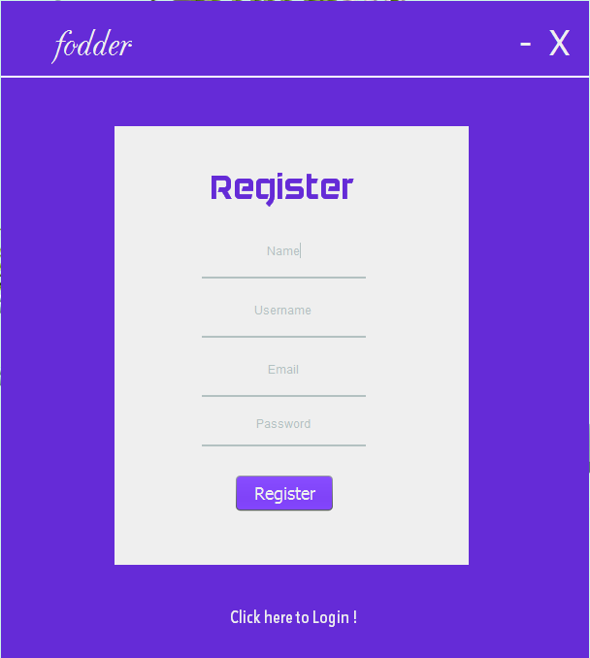
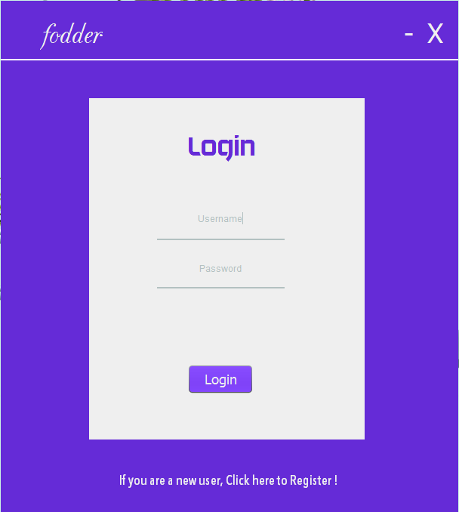
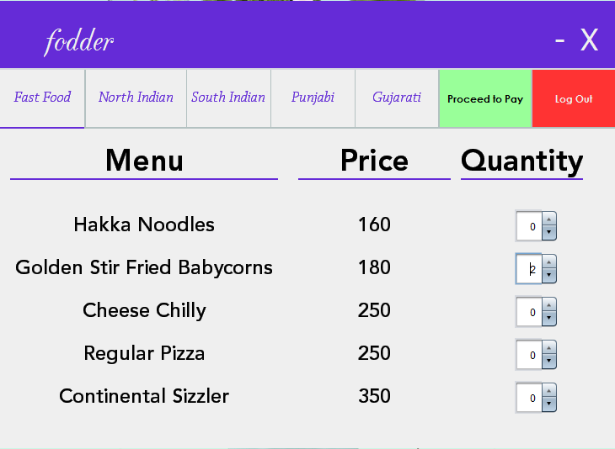
Customer Workflow
1
Customer registers if he has not registered before.
2
Customer logins into the
Software.
3
Customer selects from a wide variety of cuisines and increments the count of the food item he wishes to order. The price of each food item is listed along side the item.
1
2
3

Slide 4
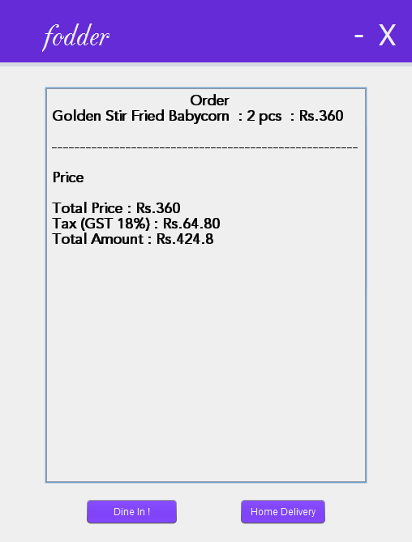
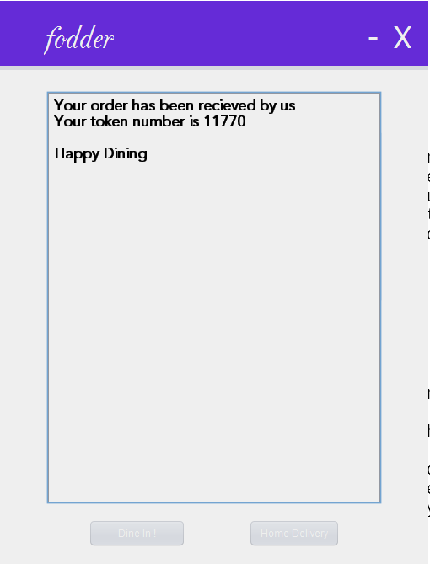
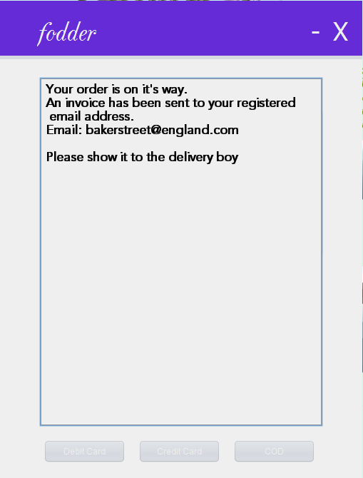
Customer Workflow
4
Customer proceeds to pay.
5
Customer checks the total amount and the taxes imposed and selects the option to either dine-in or
home delivery.
6
Customer then selects his mode of payment and enjoys.
4
5
6

Slide 5
Key Functions
User registration
User login
Fast Food Details
Indian food items
South Indian food list
Punjabi & Gujarati foods
Shopping Cart
Billing
Mode of payment

Slide 6
Technologies Used
Language : Java
Framework/Libraries : Swing, AWT
Database : MySQL
Version Control System : Git

Slide 7
Steps To Run The Software
Install MySQL server from the official website.
Create a user with username – ‘root’ and password – ‘root’.
Create a database – ‘fodder’.
Grant all privileges on database ‘fodder’ to the user ‘root’.
Create a table ‘users’.
Run the jar file of the software.

Slide 8
Final Deliverables
Source code of the working software.
Executable jar file.
UML Diagrams.
Project Report.

Slide 9
Our Team
Harshit Jain
IIT2016060
Himank Goel
IIT2016061
Prajal Bhandari
IIT2016056
Harsh Jain
IIT2016079
Pulkit Jaroli
IIT2016081

Slide 10
Our Sources Of Knowledge
• Java The Complete Reference – Herbert Schildt
• Java Study Guide – Kaithy Sierra
• Oracle Documentation
• Stack Overflow

